Slide 1
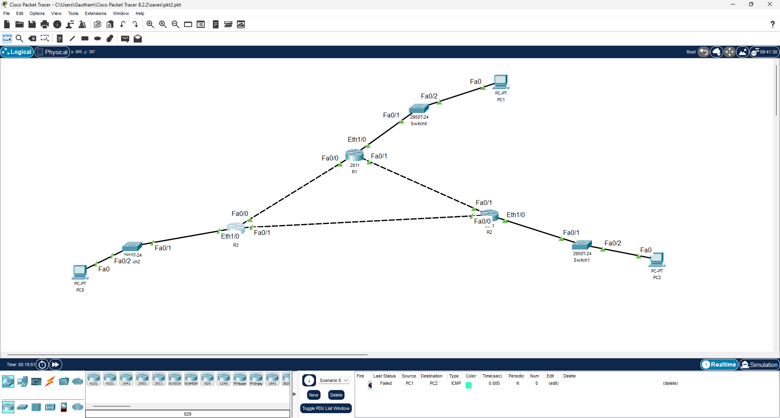
Topology

Slide 2

Charlie pinging HQ

Slide 3
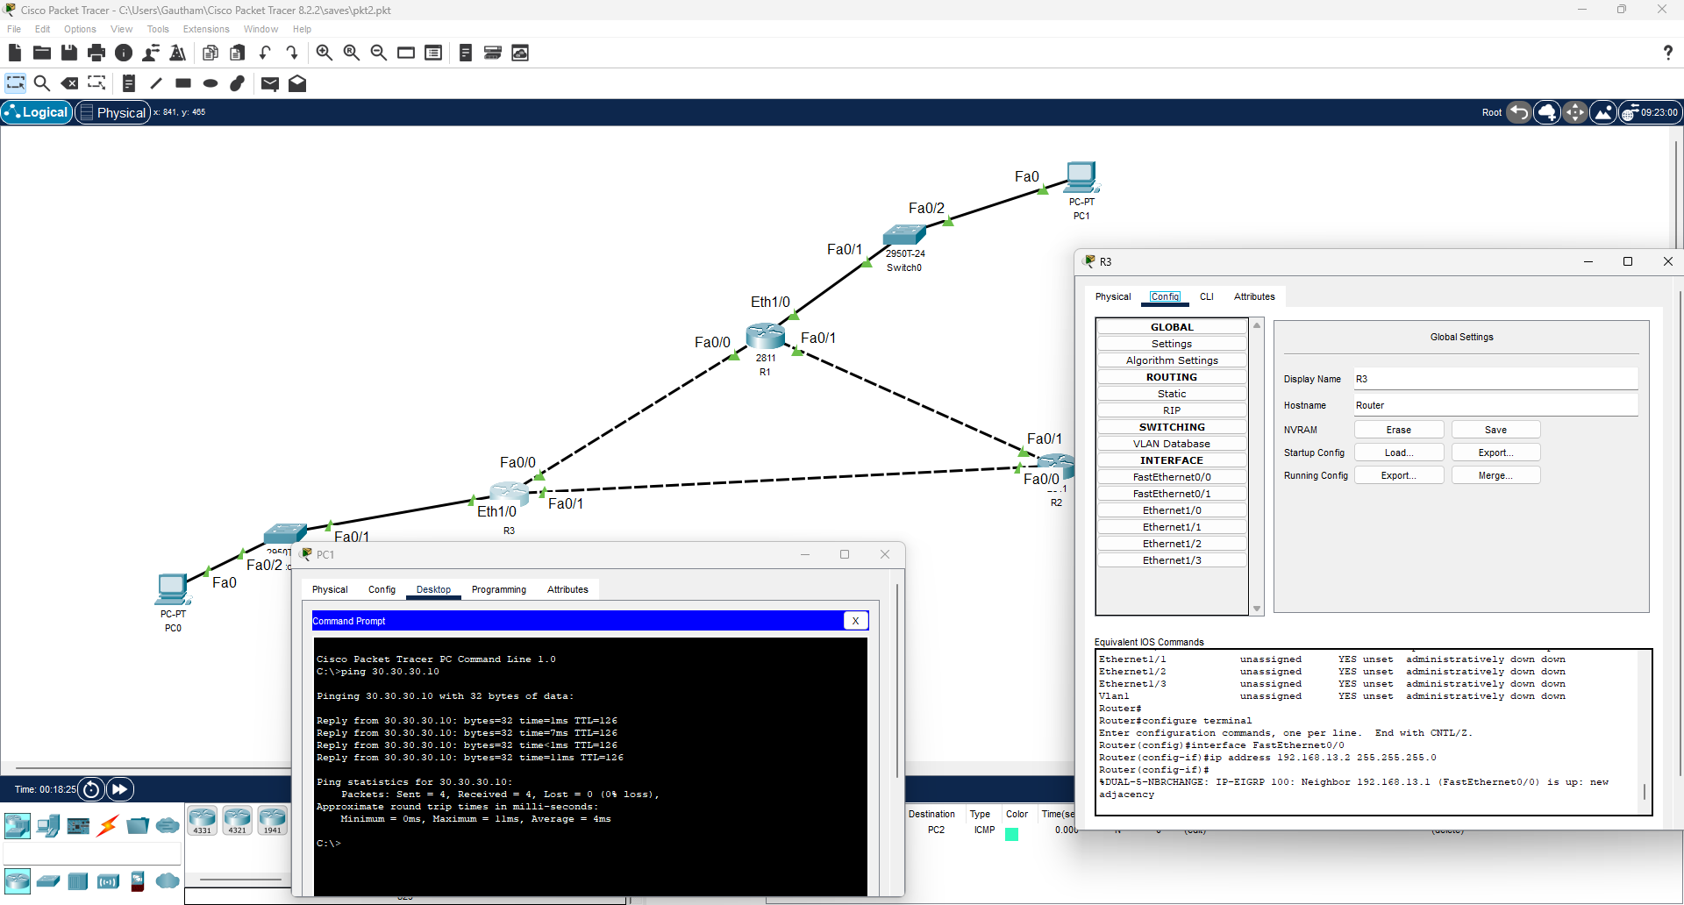
Charlie on EIGRP

Slide 4
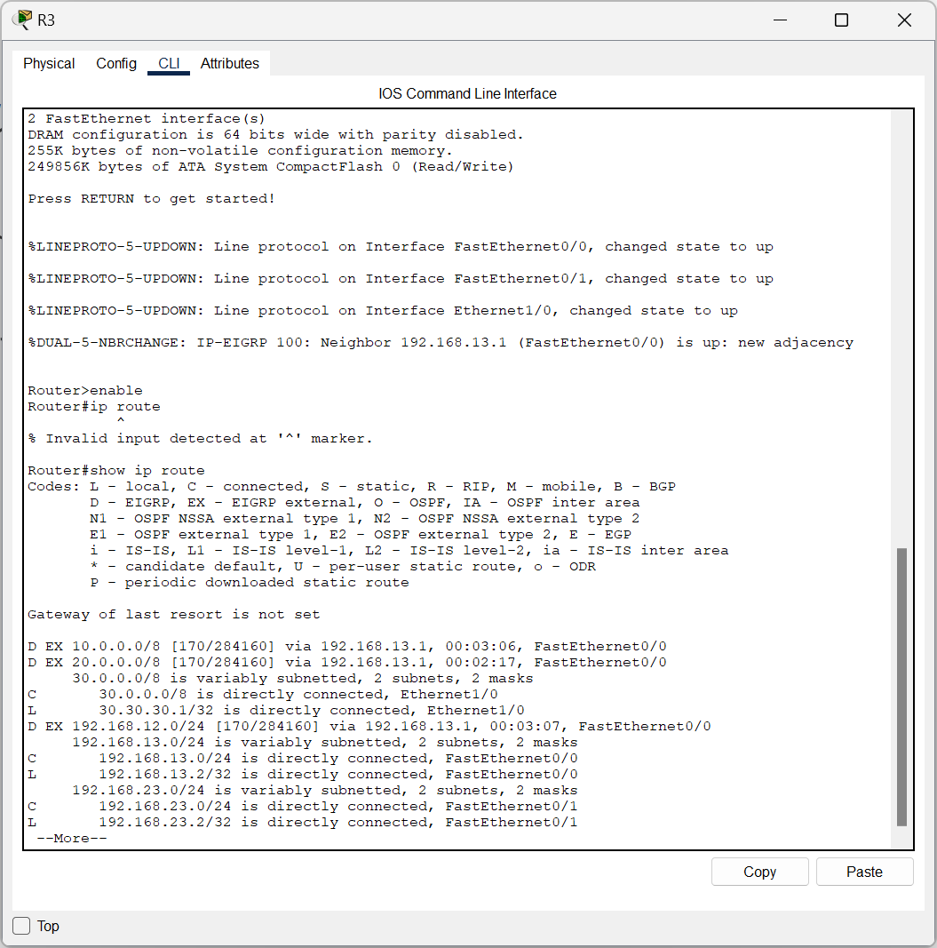
IP route r3

Slide 5
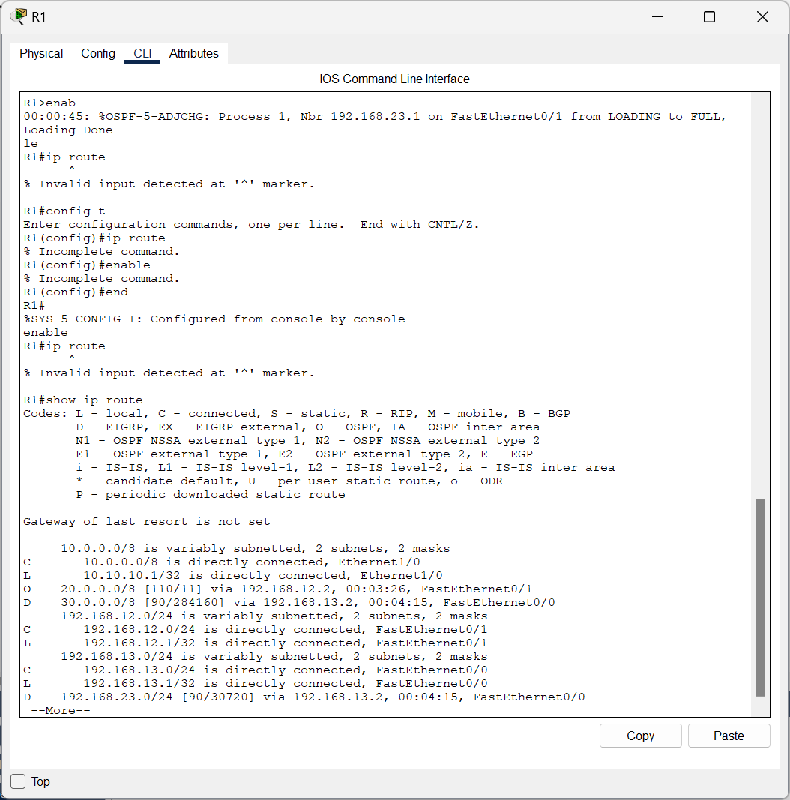
IP route r1

Slide 6
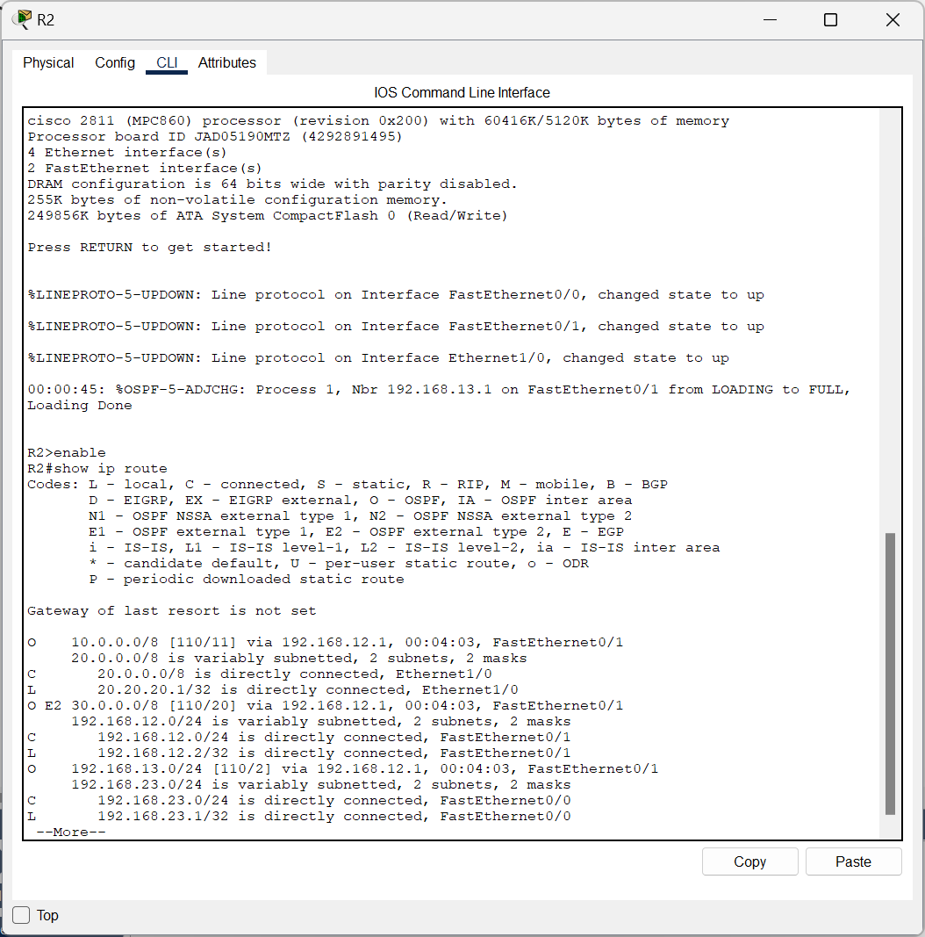
IP route r2

Slide 7
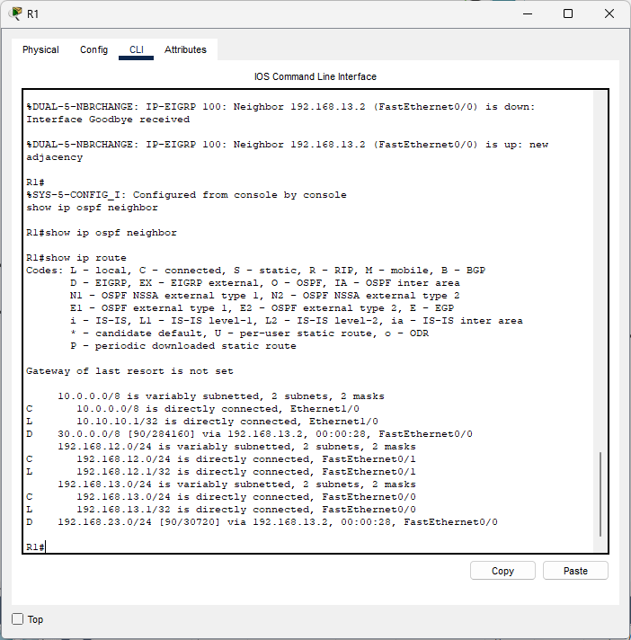
Missing netwk statement on r1
configure terminal router ospf 1 no network 192.168.12.0 0.0.0.3 area 0 end stops linking to r2 because ospf stops sending hellos can be restored by
configure terminal router ospf 1 network 192.168.12.0 0.0.0.3 area 0 end

